Slide 1

Department of Information Technology
NBA Accredited A.P. Shah Institute of Technology G.B.Road, Kasarvadavli, Thane(W), Mumbai-400615 UNIVERSITY OF MUMBAI Academic Year 2022-2023

Slide 2
A Project Report on Developing Real-time and Secure Attendance Management System using Blockchain and ML Submitted in partial fulfilment of the degree of
Bachelor of Engineering(Sem-8) in INFORMATION TECHNOLOGY By Sindura Rajendra Dasi(19104015) Ekta Shantaram Gujar(19104026) Abdul Samad Mohd. Islam Ansari(19104022) Under the Guidance of Prof. Yaminee Patil

Slide 3
1. Project Conception and Initiation

Slide 4
1.1 Abstract
Traditional methods of conducting attendance is inefficient, inaccurate and time consuming.
Furthermore, the data collected manually has to fed into a machine to safekeep a soft copy in case the physical one is damaged.
So, the proposed solution is a facial detection based attendance system that automates the process and solves the issues with inefficiency and inaccuracy.
Storing the data on a blockchain network solves the problems with security.

Slide 5
1.2 Objectives
To implement a real-time attendance monitoring system using OpenCV.
To secure the attendance records using blockchain technology and Solidity.
To create a dashboard for the faculty to monitor the records using Flask.

Slide 6
1.3 Literature Review
Sr. No. | Title | Key Findings | Year
1. | Design of A Blockchain-based Employee Attendance System | The system was built in a decentralized and distributed way such that there is no central authority and stored data can be retrieved easily. | 2019
2. | Real Time Attendance System Using Face Recognition Technology | The system matches input with various facial images and outputs eigenfaces that match the given input. Using OpenCV has also been beneficial to reduce the cost of the system. | 2020
3. | Automated Attendance System Using OpenCV | The system makes use of the LBPH technique of OpenCV and the KNN algorithm. As an output, the system generates a spreadsheet having the names of present students. | 2020

Slide 7
1.4 Problem Definition
Organizations face various challenges with traditional manual attendance tracking systems .
The ever-growing count of students increase the pressure on professors to monitor and control the attendance.
One emerging problem among various countries is the falsification of attendance.
Traditional methods of conducting attendance is inefficient, inaccurate and time consuming.
To address these challenges, there’s a demand for a secure and efficient attendance monitoring system that utilizes advanced technology.

Slide 8
1.5 Scope
Can be useful for teachers to monitor the attendance of students.
Can be used to avoid the falsification of attendance.
Can be used to save time.

Slide 9
1.6 Technology stack
OpenCV (version 4.6.0)
Solidity (version 0.8)
Blockchain – Ethereum
Ganache
Flask (version 2.0)
Web3 (version 1.9.0)
Truffle suite

Slide 10
1.7 Benefits for Society
Developing a real-time and secure attendance management system using blockchain and machine learning can improve accuracy, reduce costs, and increase efficiency.
The system can enhance security by preventing tampering and unauthorized access.
Transparency is also improved as all parties can access attendance records in real-time.
The benefits can be applied to educational institutions and other organizations.

Slide 11
2. Project Design

Slide 12
2.1 Proposed System
Facial Recognition:
Facial data of students will be used to train a model and a video feed will be fed to the model to recognize the students present in a given class
Security:
Blockchain will be used to store the facial data as well as attendance record to prevent attacks.
Dashboard:
A web portal will be available to the users in order to view the data in case the system makes an error.

Slide 13
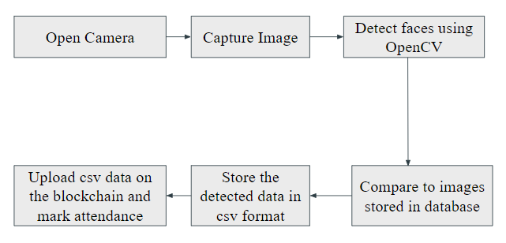
2.2 Design(Flow Of Modules)

Slide 14
2.3 Description Of Use Case
An educational institutes could use the system to automatically track student attendance using facial recognition technology, reducing the need for manual record-keeping and improving accuracy.
The use of blockchain technology could ensure that the attendance records are secure and tamper-proof, preventing any unauthorized changes or deletions.
The system could be used by large organizations with multiple locations, enabling them to track attendance across all sites in real-time and ensuring consistency in attendance management.

Slide 15
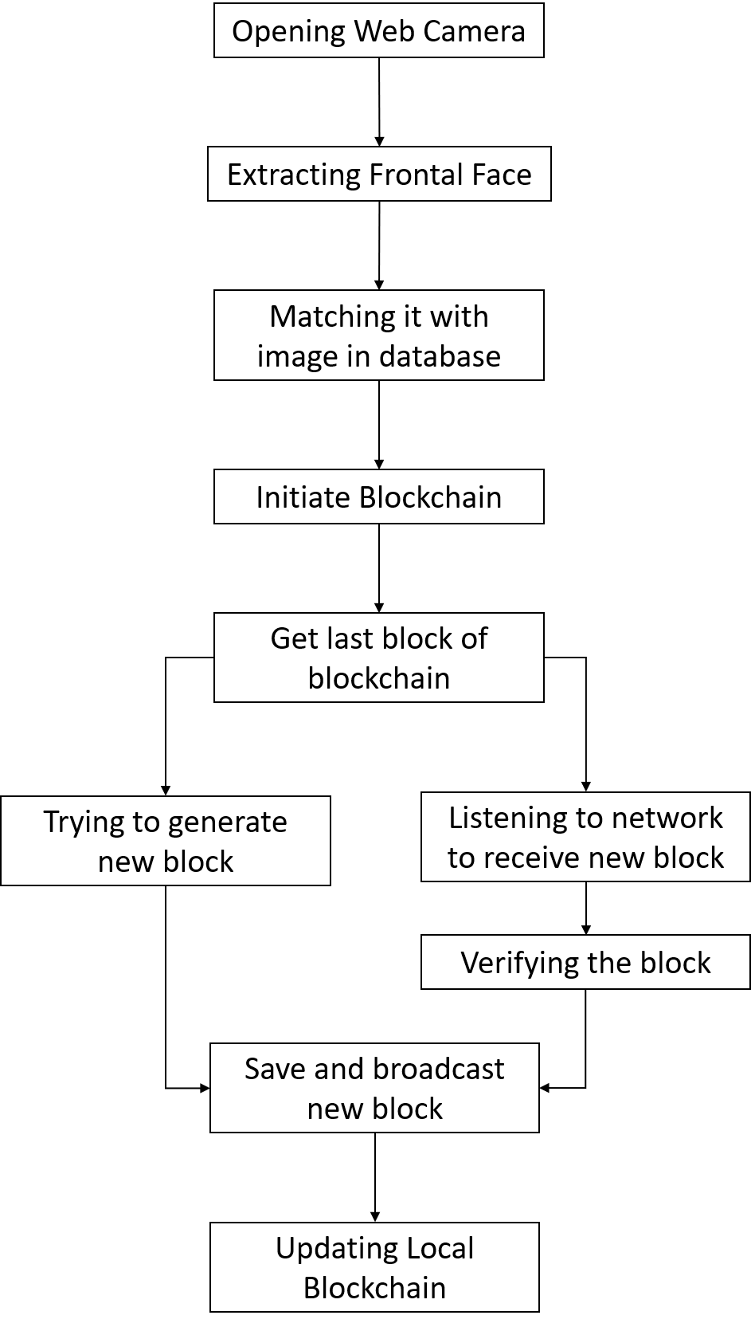
2.4 Activity diagram

Slide 16
3. Implementation

Slide 17
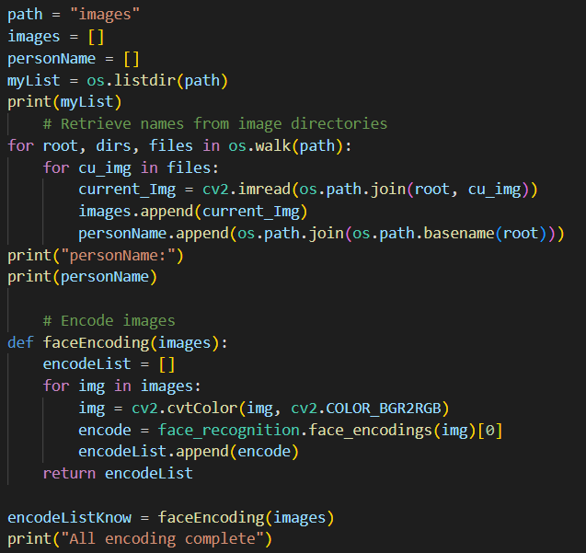
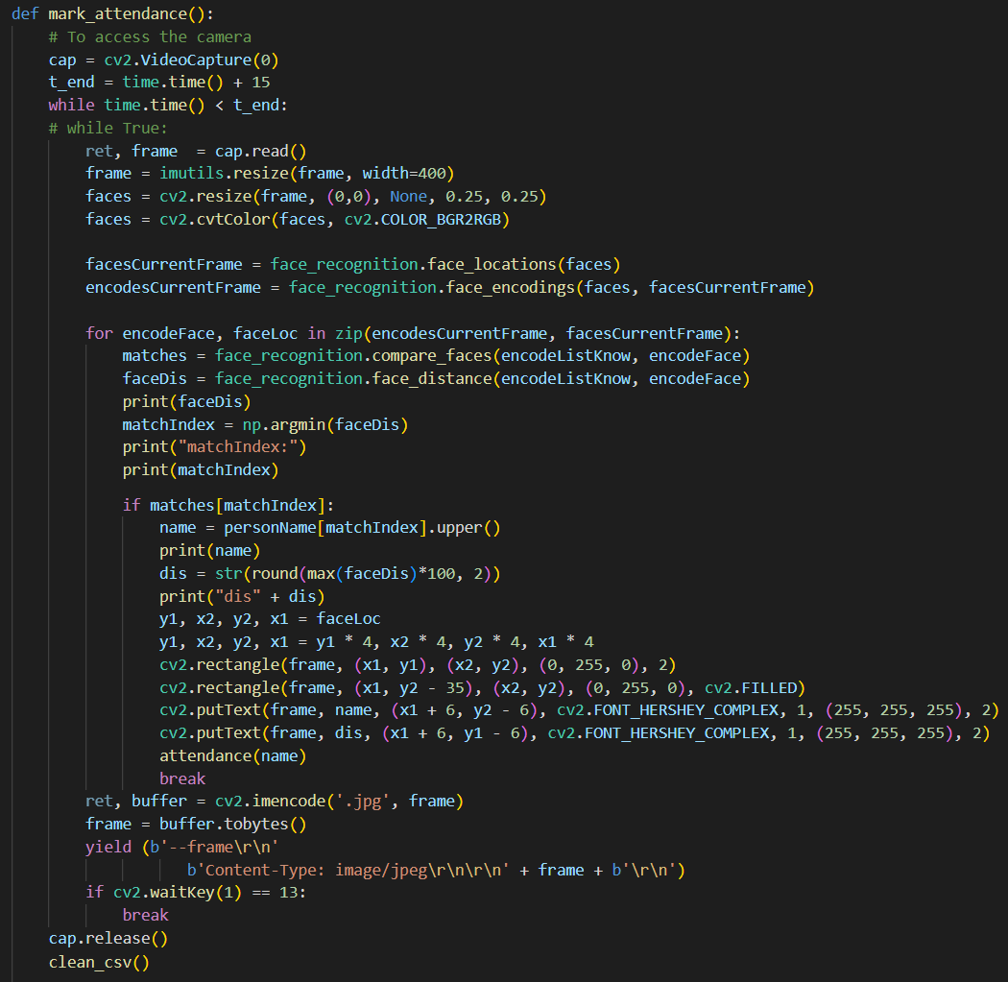

Slide 18
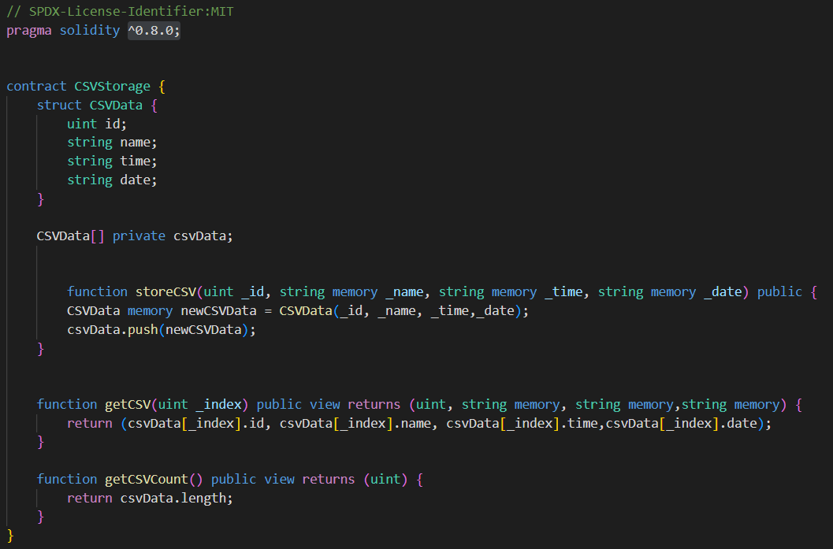
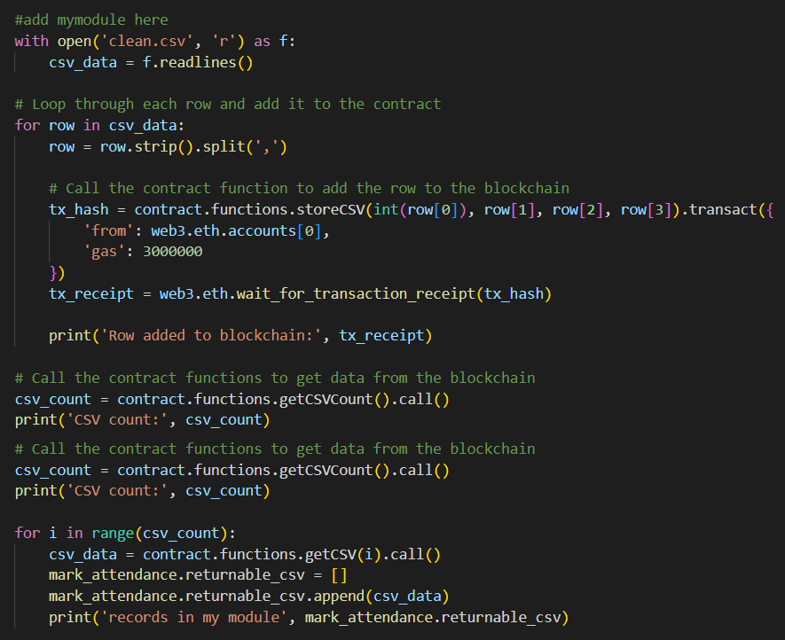

Slide 19
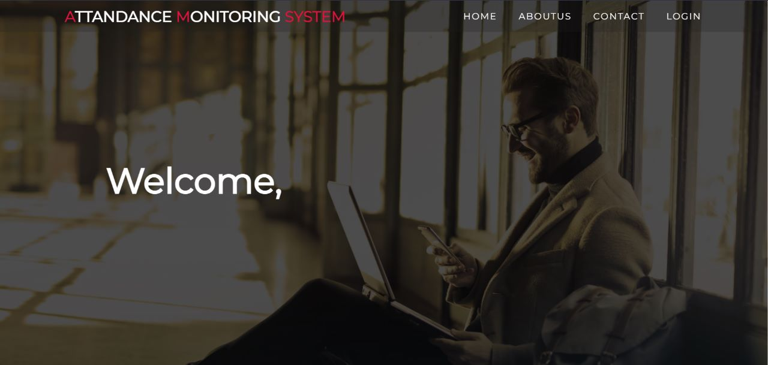
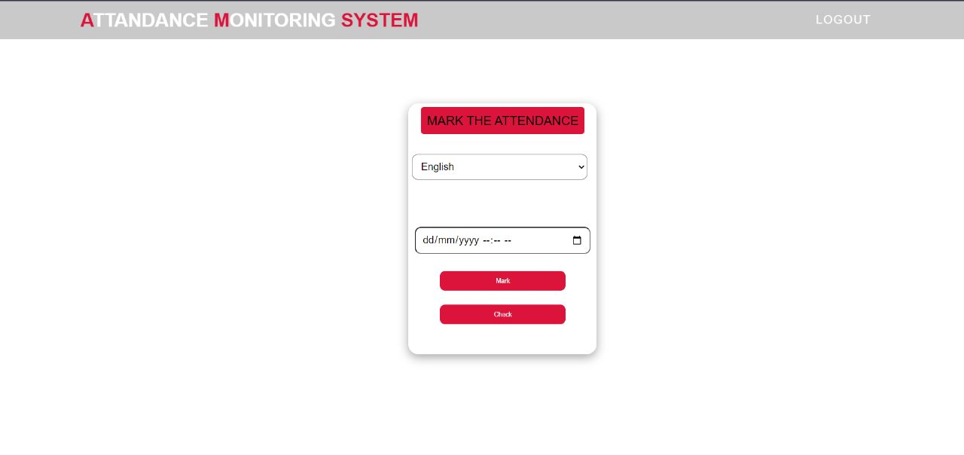
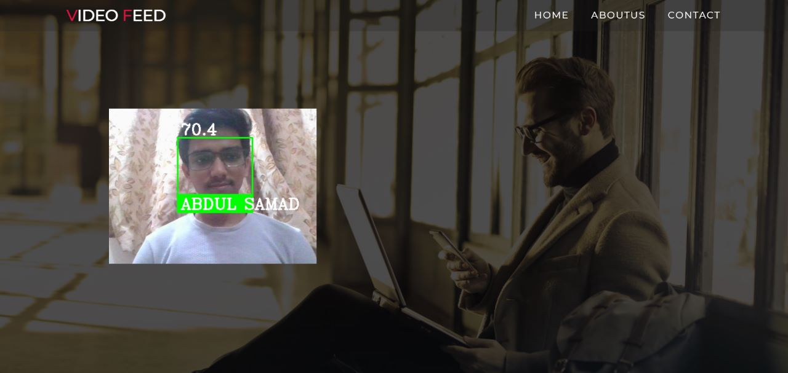
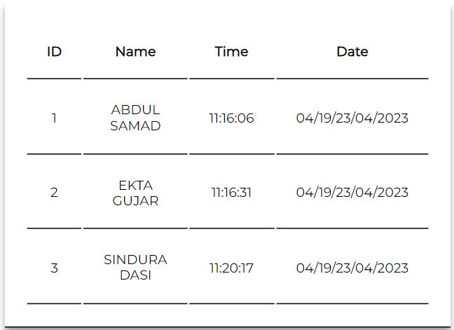

Slide 20
4. Testing

Slide 21
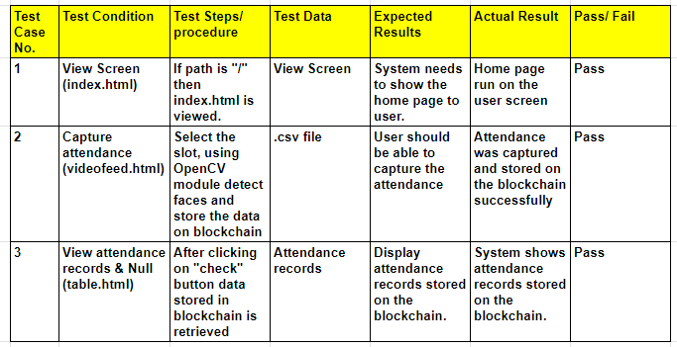

Slide 22
5. Result

Slide 23
Using the Interface, the user can interact with OpenCV and blockchain modules efficiently.
User can login using valid credentials and can select subject and time-slot to mark the attendance.
System detects student faces with the help of OpenCV and the data is generated in .csv format.
The generated data is stored on the Ethereum blockchain in order to provide immutability.
The stored data can be viewed by users at any time.

Slide 24
6. Conclusion and Future Scope

Slide 25
The integration of blockchain technology with facial recognition-based attendance recording systems has been established successfully.
System provides a secure and efficient solution for monitoring attendance.
The technology offers several benefits, including increased security and transparency, as well as a more efficient and streamlined process for recording and processing attendance data.
In future work, it would be interesting to explore new algorithms to be developed in order to increase the accuracy and efficiency of the system.

Slide 26
References
Mayank Srivastava, Amit Kumar, Aditya Dixit, Aman Kumar, "Real Time Attendance System Using Face Recognition Technique", 2020 International Conference on Power Electronics & IoT Applications in Renewable Energy and its Control (PARC), 28-29 February 2020.
Hasna Ardina, I Gusti Bagus Baskara Nugraha, “Design of A Blockchain-based Employee Attendance System”, 2019 International Conference on ICT for Smart Society (ICISS), 19-20 November 2019.
Naman Gupta, Purushottam Sharma, Vikas Deep, Vinod Kumar Shukla, "Automated Attendance System Using OpenCV", 2020 8th International Conference on Reliability, Infocom Technologies and Optimization (Trends and Future Directions) (ICRITO), 4-5 June 2020.

Slide 27
Paper Publication
Paper entitled “Real-time Attendance Monitoring System using Machine Learning and Blockchain” is presented at “11th International Conference on Emerging Trends in Engineering & Technology Signal and Information Processing(ICETET SIP-23)” by “Sindura Rajendra Dasi, Ekta Shantaram Gujar, Abdul Samad Mohd. Islam Ansari and Prof. Yaminee Patil”.

Slide 28
Thank You

